Slide 1

Movie Studio Feasibility
Fictional Client: Microsoft
Investigating Viability of Entering the Movie Industry

Slide 2
Overview of Data Sources, Metrics, Investigations
Feasibility study is based on data from IMDB, BOX office mojo, rotten tomatoes, themoviedb, and thenumbers
1) How is overall movie gross product trending compared to the economy?
2) Are films’ critical rating and ROI correlated?
3) Do high or low-budget films tend toward better roi/rating?
4) Do films of certain genres tend toward better roi/rating?
5) Do films with certain ratings (g-pg-r) tend toward better roi/rating?
6) What is the current market share of current studios & what are their roi/Critical ratings?
Primary Metrics of Success
: -Return on investment
-Critical rating

Slide 3
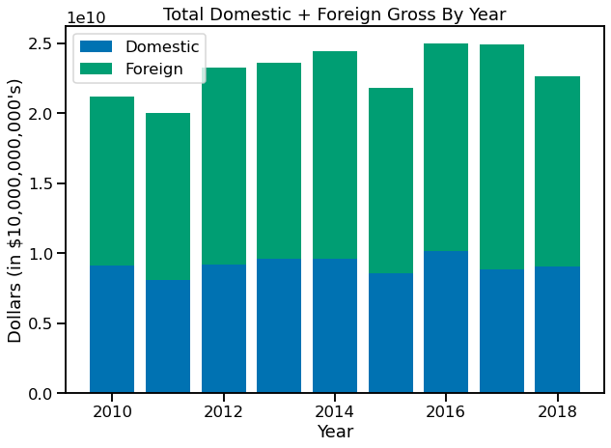
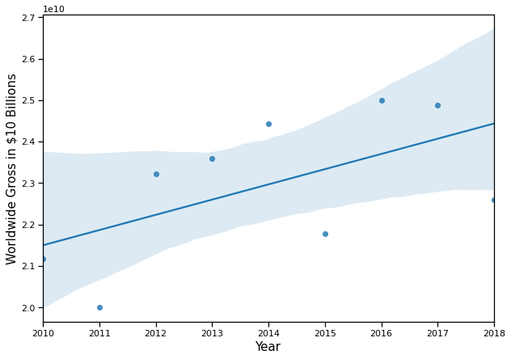
How is Overall Movie Revenue Trending? (Question 1)
- There is an overall positive regression trend in revenue from 2010 to 2018 of 1.6% per year on average. The confidence interval shown is 95%
-There is some variance/instability but the raw dollars in the industry are growing. However, inflation rate was 1.79% on average for that time period.
-Impact of COVID-19 is not shown in this study

Slide 4
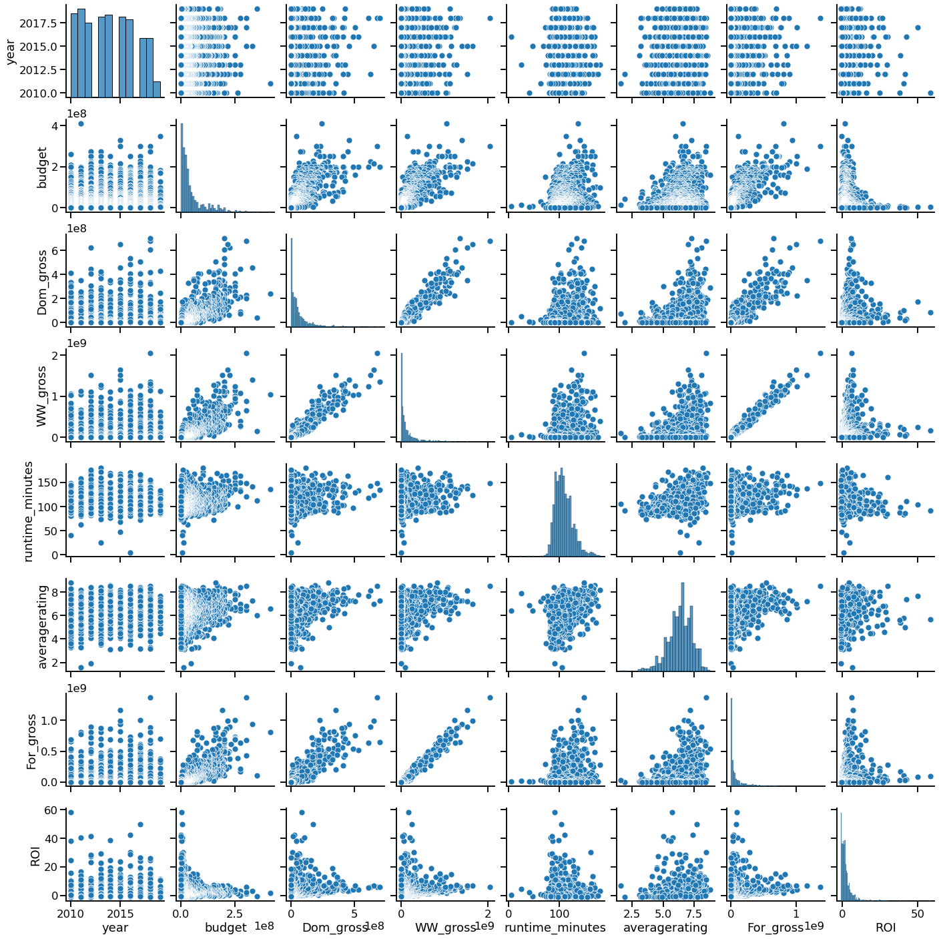
Are films ROI/Critical Rating Correlated? (and what about any other factors?) (Questions 2-3)
-For question 2, there is not a strong relation between return on investment and any other category.
-Runtime has a sizable correlation to rating - but not to ROI - but not high enough to make much in the way of prediction. Possible area of further study.
-To our question 3, Budget has a .22 correlation coefficient with average rating - not above our usual threshold of 0.6, but not insignificant either.
-Budget has a small negative correlation with ROI which we will classify as insignificant.
-One other takeaway here is that if the client were to target ROI or Critical Rating success, they would not necessarily find success in the other category.

Slide 5
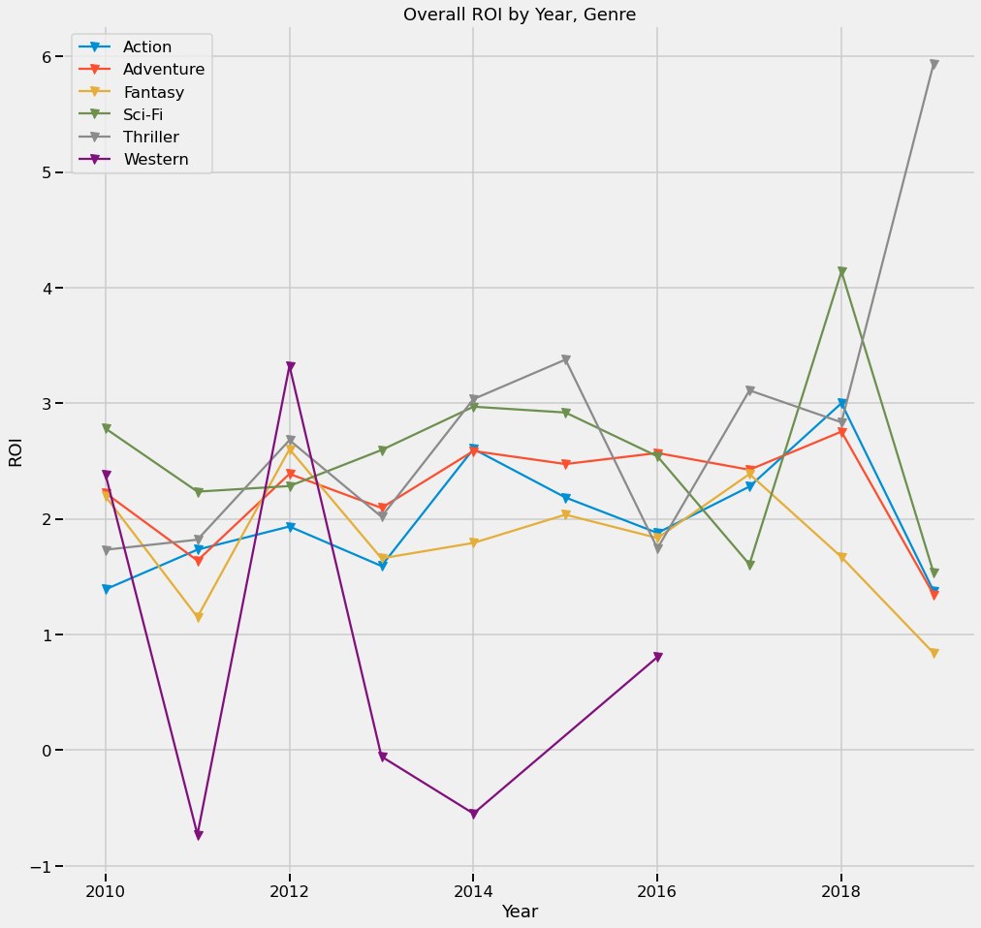
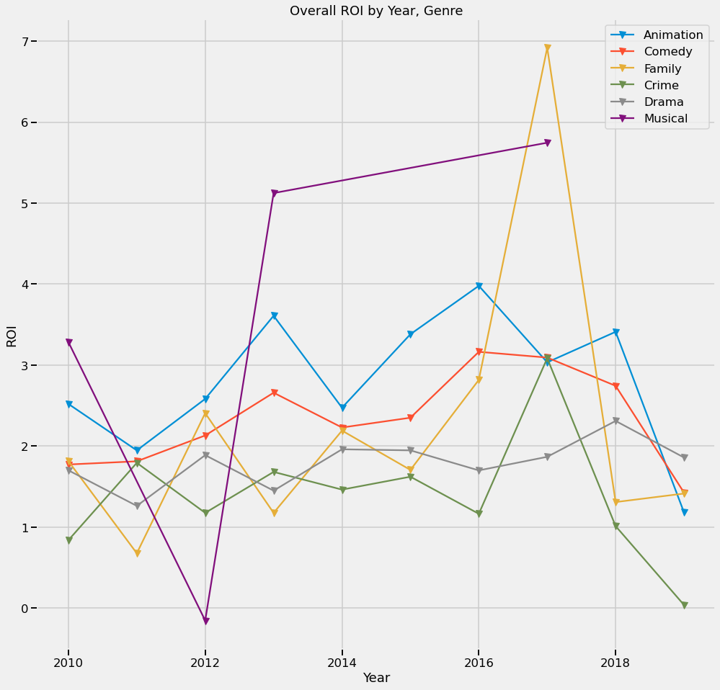
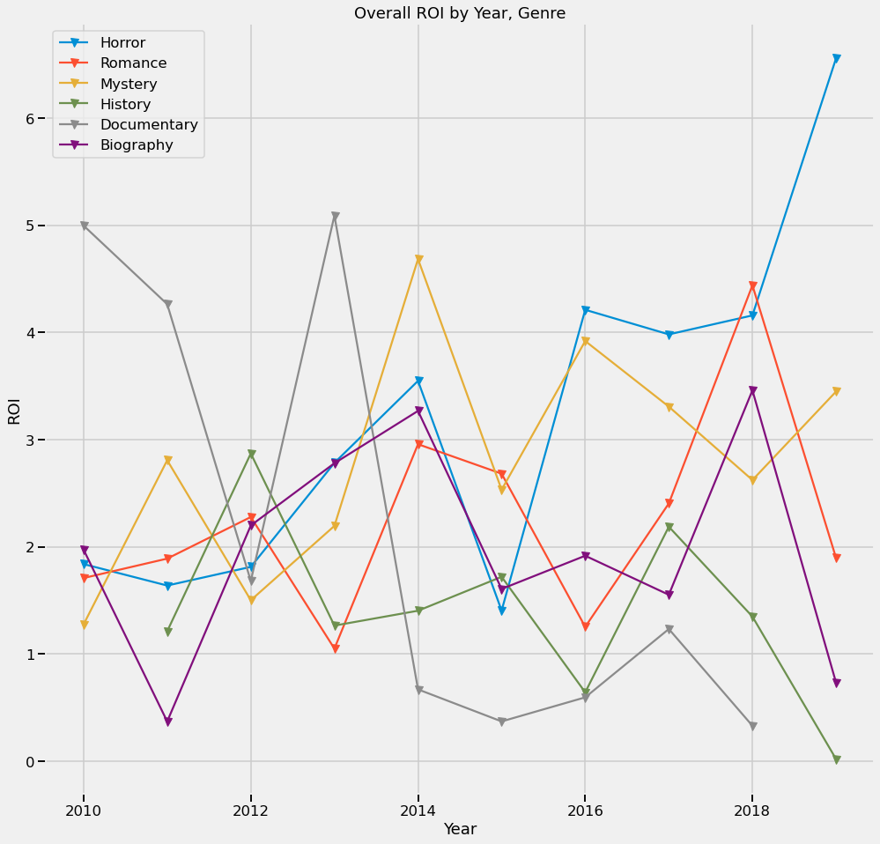
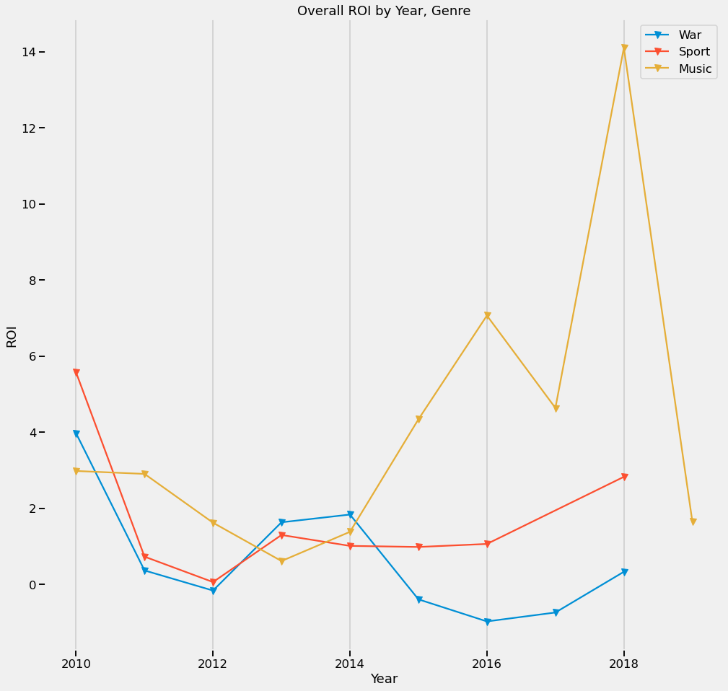
Is Genre associated with ROI? (question 4-a)
-These graphs are of Year vs. ROI, with different genre trends shown.
-Sci-fi, adventure, animation, comedy are very stable and successful
-other genres (e.g. Music) have periods of high success but are unstable

Slide 6
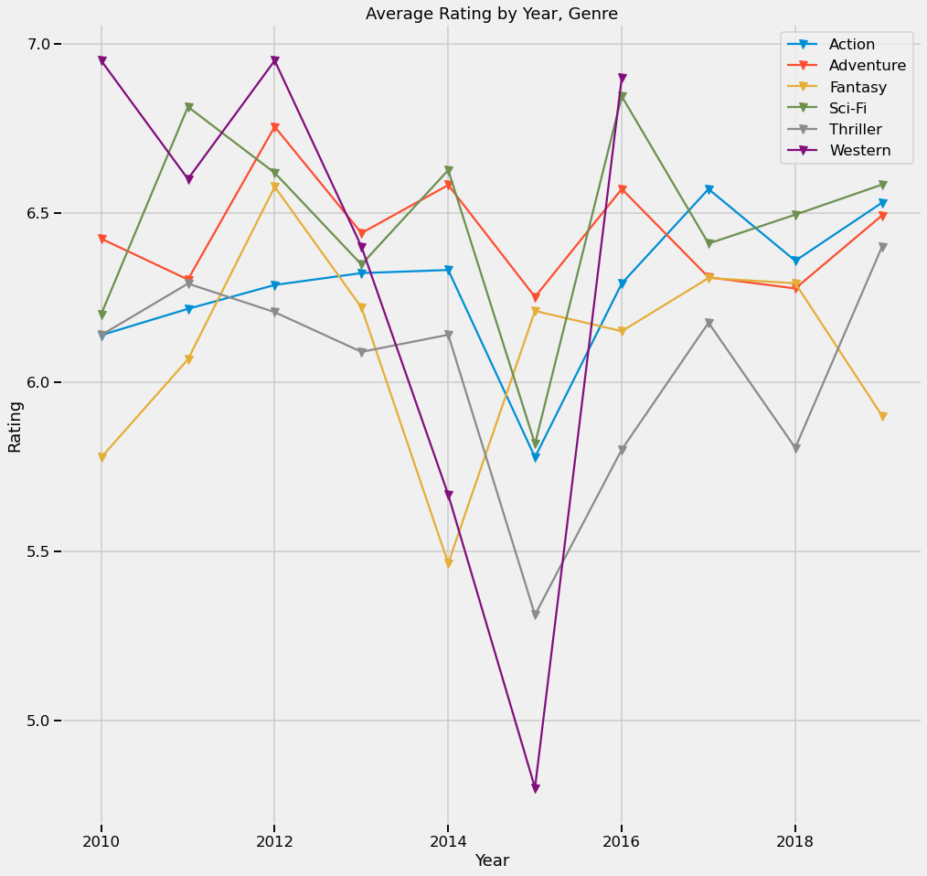
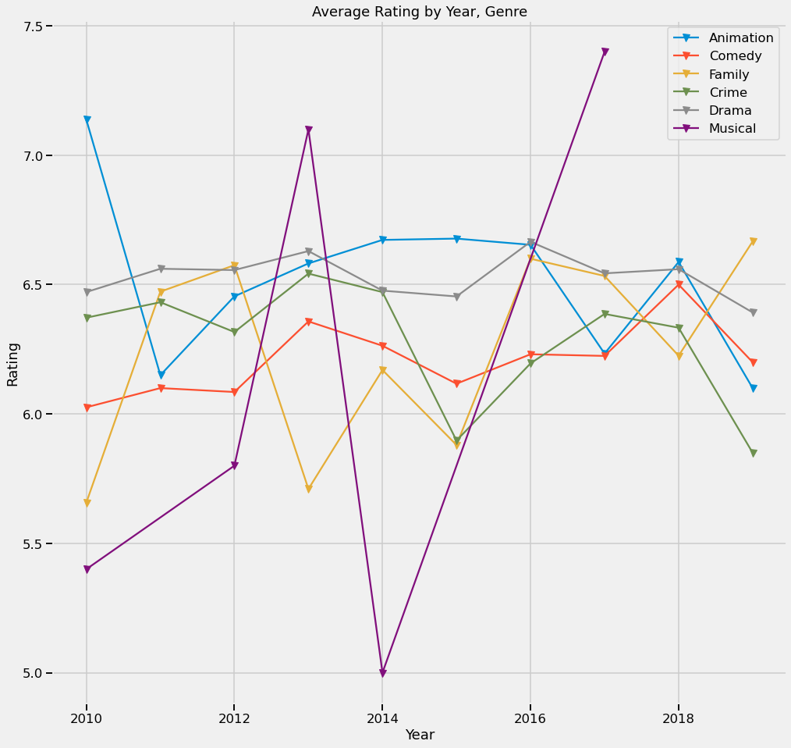
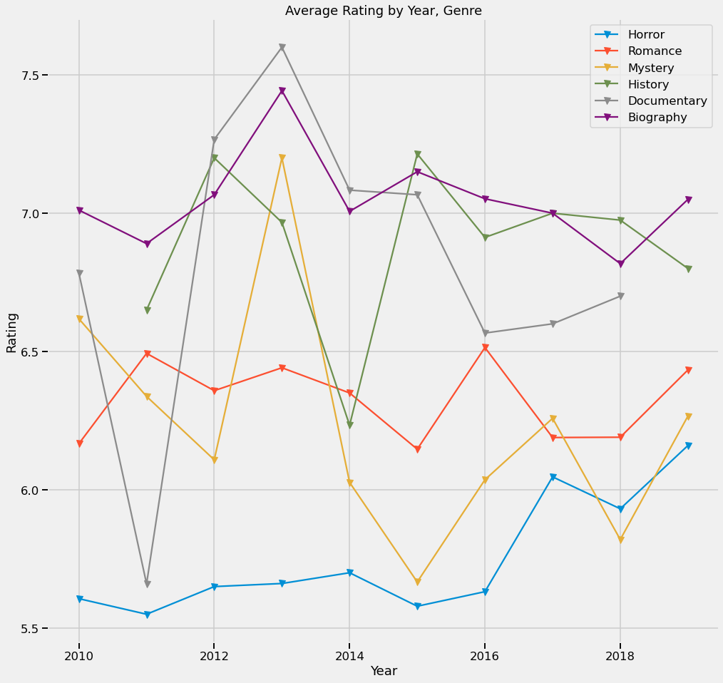
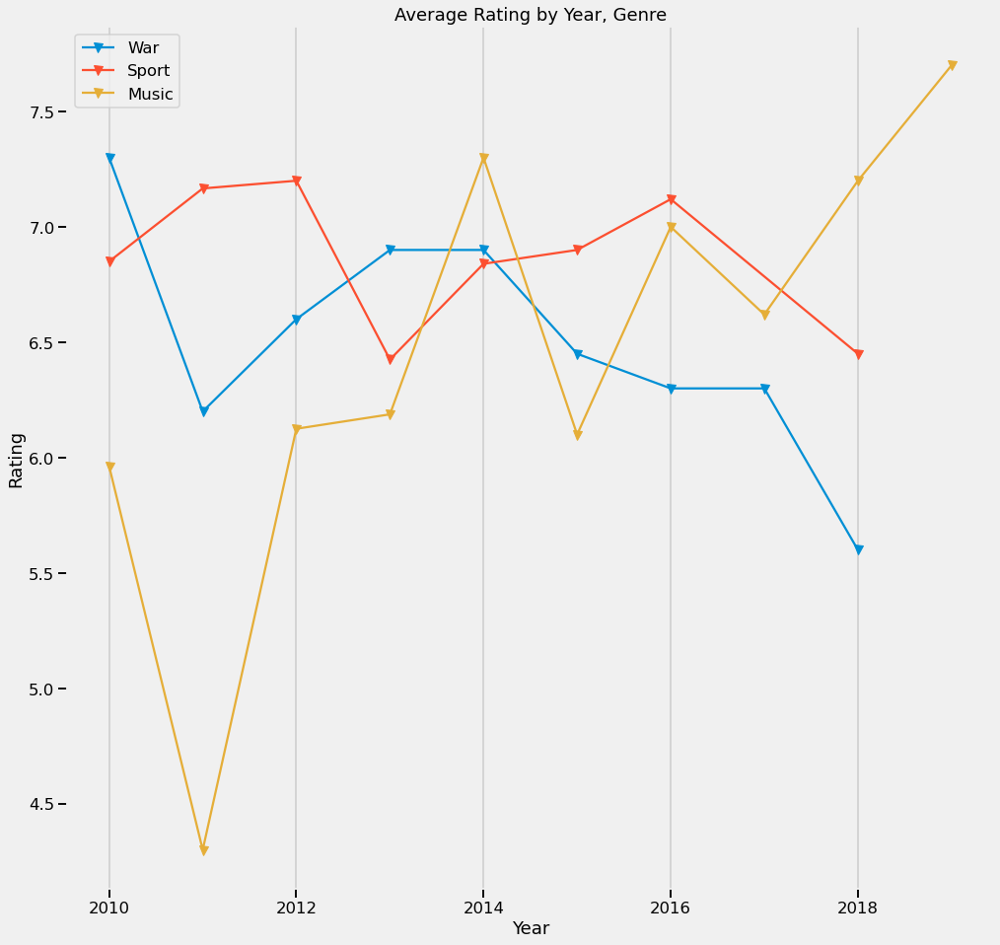
Is Genre associated with Rating? (question 4-b)
-Sport, Biography, History, Sci-Fi are generally stable for rating
-Music/Musicals have high points but also low points
-Horror is generally not critically rated well

Slide 7
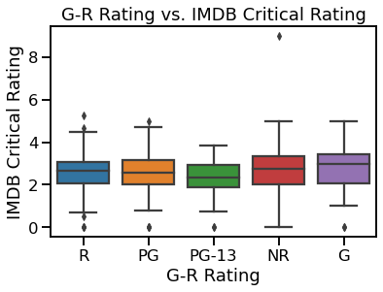
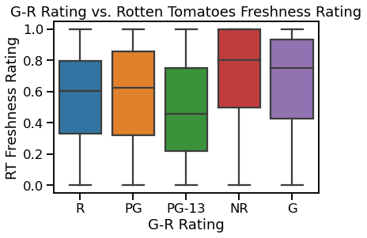
Do films with certain ratings (ie. G-PG-R) tend to have better Critical Rating? (question 5)
-Not Rated films tend toward higher mean, with more variance
-G-rated films have a high average critical rating
-PG-13 films tend to be critically regarded the lowest
-Consider also studios who tend toward making each type and their quality (e.g. Disney/BV)

Slide 8
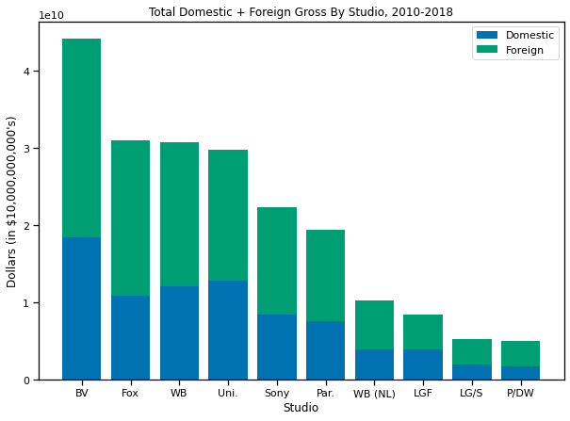
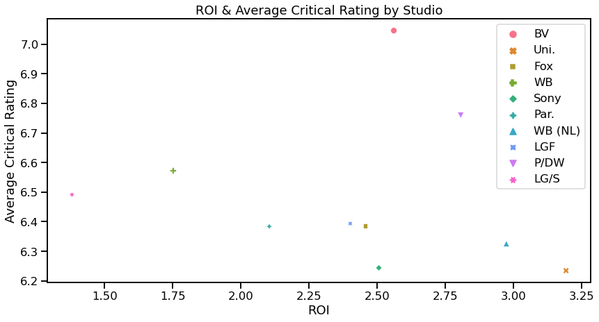
What is the current market share of current studios, and what are their ROI/Critical Ratings? (Question 6)
-BV(Buena Vista – Disney) holds the highest market share; WB has two studios which combine to a similar value
-Strongest Rating/ROI studios are in the upper right of the lower graph (BV, P/DW, WB(NL), Uni)
-Weaker studios include LG/S, WB, Par., Sony)
-BV’s strength is anecdotally due to the strong performance of Marvel movies over the last decade, but also due to their reliable G-rated animated films

Slide 9
Business Conclusions/ Actions
1) Movie industry revenue is growing though not outpacing inflation. This could indicate an opening. COVID-19 was a huge shock to the system, shuttering theaters but giving a surge to home-viewing, a shift that could be an opportunity, but also a field with a great deal of uncertainty. Proceed but with an eye on innovation to meet new patterns of viewer behavior.
2) Critical Reception and Return-On-Investment are not well correlated. Having both metrics as goals is desirable; performing well in one does not automatically lead to the other.
3) Higher budgets do tend to produce films with better critical reception; higher budgets do produce higher gross revenue (though not necessarily higher ROI). Avoid making low-budget films to build up a quality reputation
4) Choose film genres carefully – some are stable, some are high-risk high-reward. Sci-fi films generally do well in both. Avoid horror due to its low critical rating.
5) G-Rated films tend to achieve good critical reviews – though this may be driven by BV/Disney, thus may be difficult to duplicate. Avoid PG-13 films.
6) BV(Disney), P/DW(Paramount), WB(NL)(Warner Brothers-New Line), Uni(Universal) are studios to emulate based on their ROI/Rating performance.
For our fictional client, Microsoft, these are some business conclusions to take away from our data analysis.

Slide 10
Next Steps
Some areas to investigate further:
-Analyze release date (seasonal, month, day/holiday)
-Identify successful directors/actors/combinations
-Look into correlation of runtime with movie success
-Follow analysis by year to examine any changes in trend in 2020/2021 due to COVID-19
-Examine business of streaming-only content creators to determine business advantage/viability of leveraging Microsoft’s technological edge
-Develop revenue “completion factor” to extend prediction based on initial performance
-Questions?
And Questions

Slide 11
Thank you!
Thank you for your time, consideration, and the opportunity to hear your feedback.

